Slide 1
~45 minutes
Topic 3 - Networks
IB Computer Science

Slide 2
Clients/Server
Server - a computer system or a software application that provides a service to other computer systems on the same network
Client - computer system or software application that requests a services from a server connected to the same network
Watch this video.

Slide 3
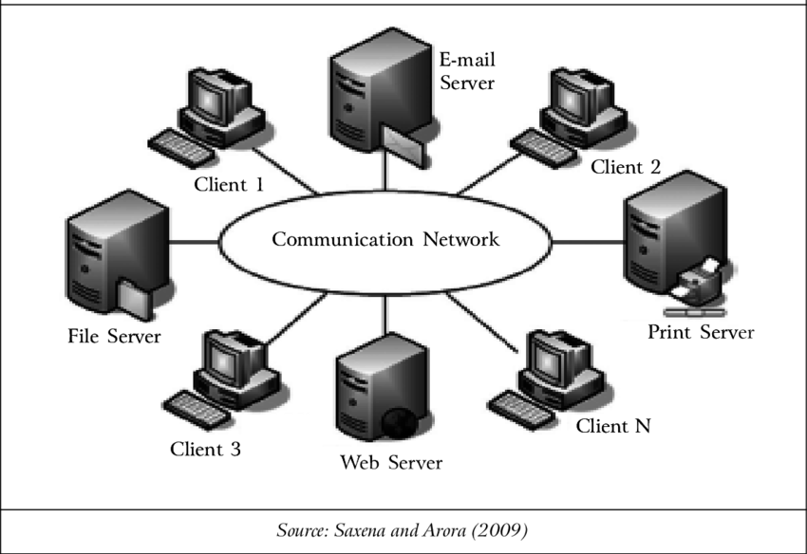
What is a computer network?
A computer network is formed when 2 or more computer are linked together.
Every computer or device on a network can send and receive data from any of the other computers or devices connected to the network.
What is a computer network?

Slide 4
What is a computer network? (Video)
https://www.youtube.com/watch?v=3QhU9jd03a0

Slide 5
Connecting Computer Systems
Hub - Connection point for devices on a single network
When a network device wishes to send data to another device on the network, it copies the data and sends it to all devices connected to its ports.
This generates a lot of unnecessary traffic on the network, slowing it down
Switch - Similar to a hub, but can identify which device is connected to which port, allowing a network connected by switches to operate much faster - data is only send to the computer that needs it
Router - Can connect multiple networks and serves as an intermediary between them (i.e. home network and Internet)

Slide 6
What is the internet?
Globally connected network system
Uses TCP/IP protocol to transmit data
No centralized governance
Hosts the webpages that make up the World Wide Web
ISPs (Internet Service Providers) run networks that provide internet access
ISPs are “glued together” by internet exchanges (IXPs)
IXPs are the key to connecting all the different ISPs and networks together - usually run and maintained by nonprofits

Slide 7
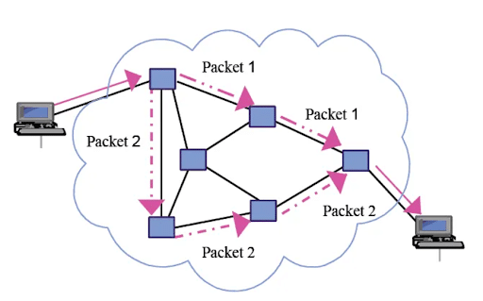
How does the internet work?
Data travels in the form of packets.
Every file you send or request you make is split up into packets over the internet.
Individual packets often take different routes through exchanges, ISPs, and junction boxes
Ultimately reach the same destination and are reassembled at destination.

Slide 8
Packet Switching
A packet is a unit of information suitable for travel through computer networks.
Data is grouped into packets.
A file being transmitted through packet switching may be divided into multiple packets and each packet could follow a different route to the same destination.
This allows for more efficient data transmission and reduced delays.

Slide 9
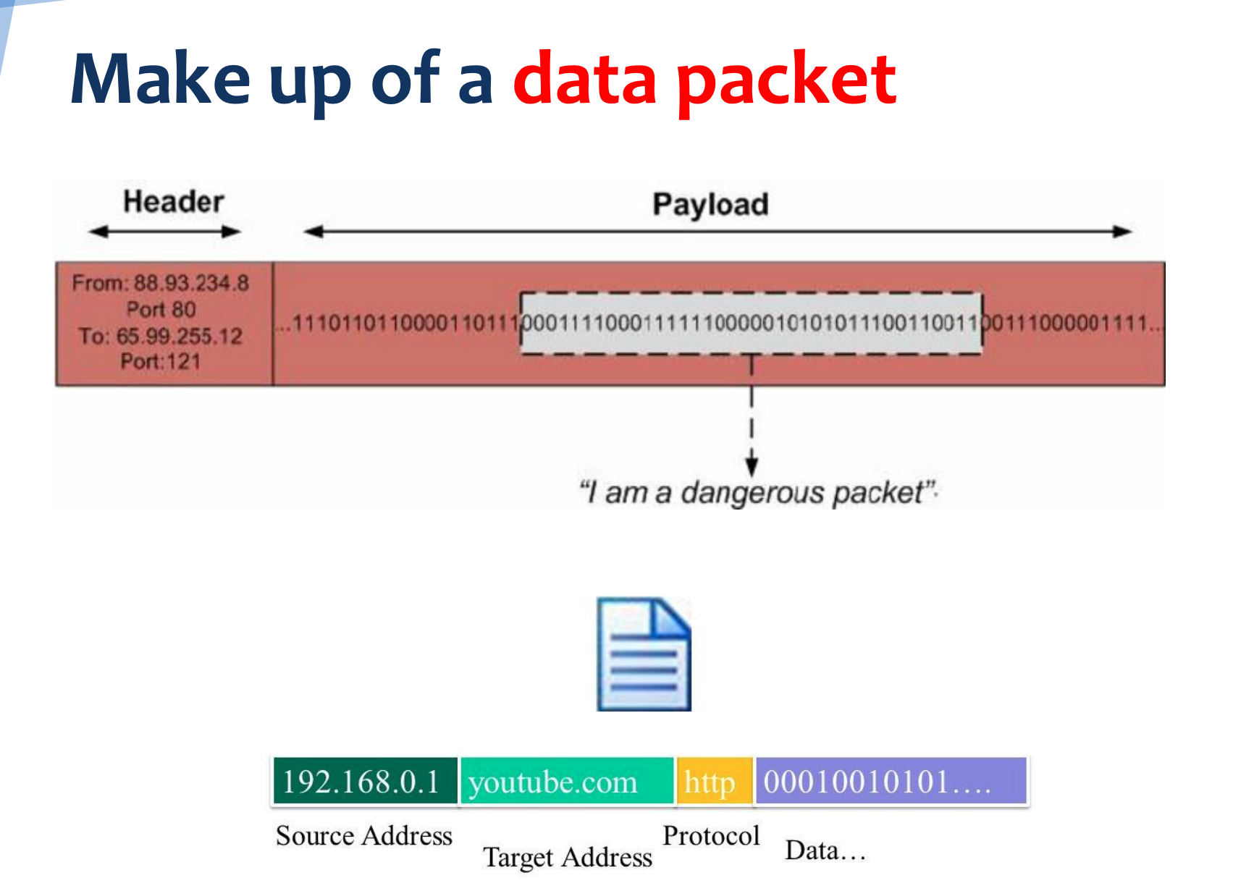
What does a data packet look like?

Slide 10
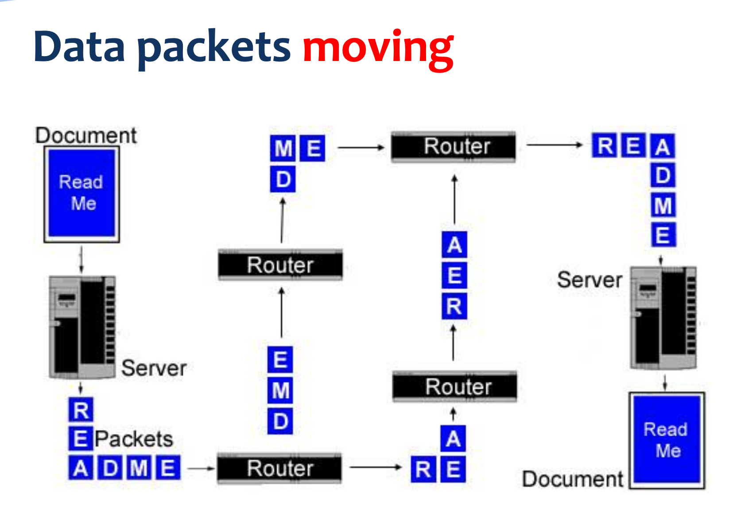

Slide 11
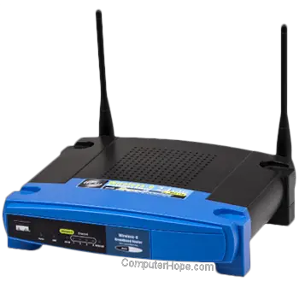
What is a router?
Used to manage traffic
Controls the flow of data packets
Checks address of data packets
Puts packets on correct path
Secure transmission

Slide 12
Packet Switching: A Video
https://www.youtube.com/watch?v=ewrBalT_eBM
Undersea Cables -
https://www.youtube.com/watch?v=IlAJJI-qG2k

Slide 13
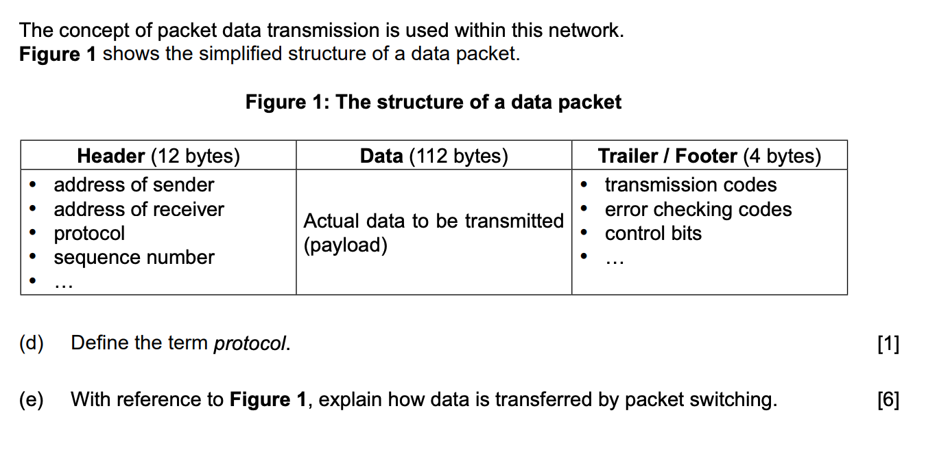

Slide 14
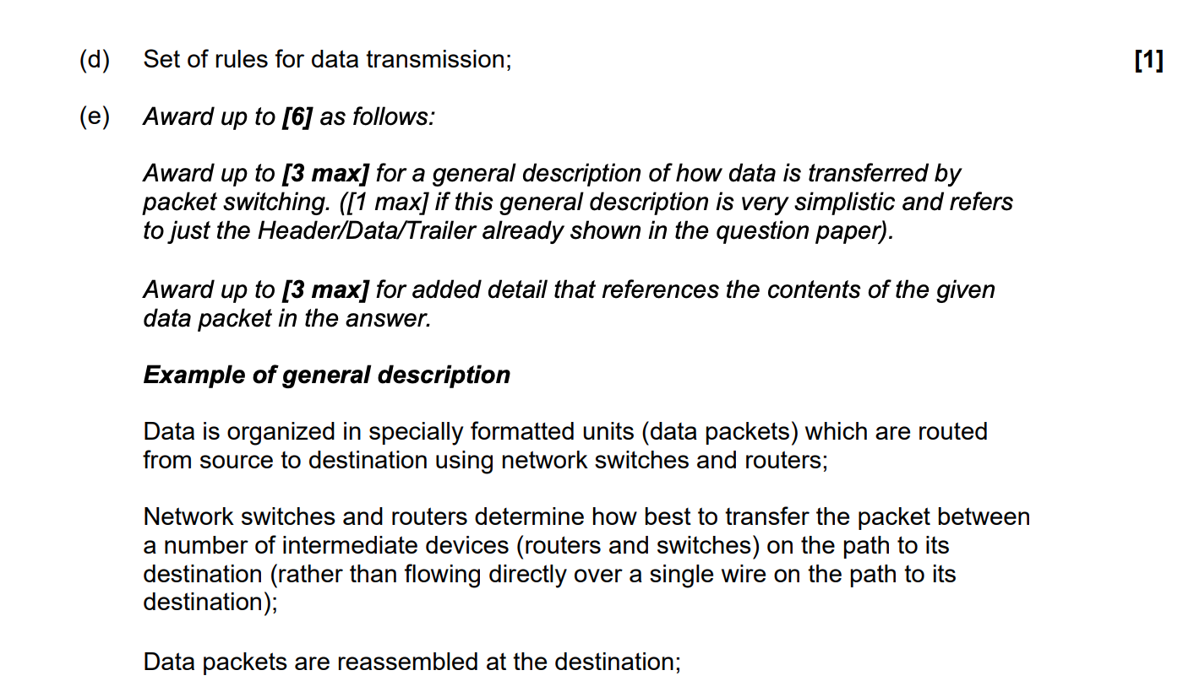

Slide 15
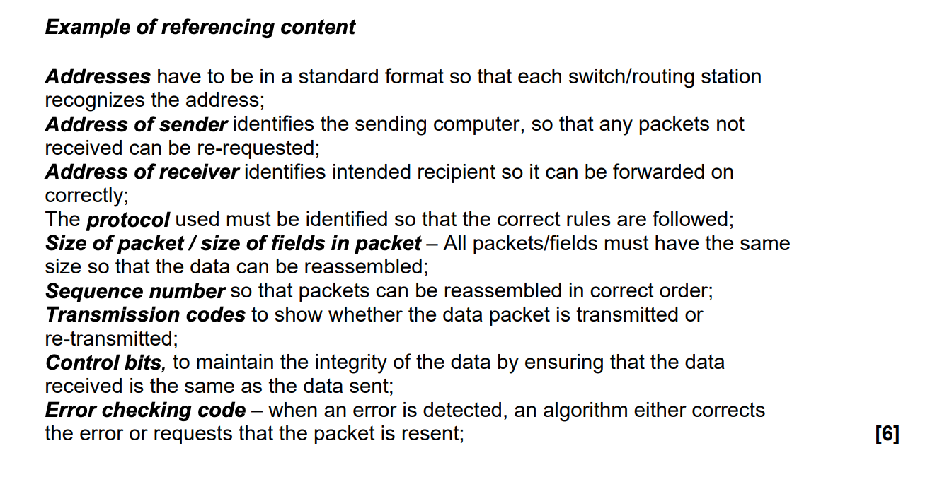

Slide 16
How does the internet work? (In 5 mins)
https://www.youtube.com/watch?v=7_LPdttKXPc&t=1s

Slide 17
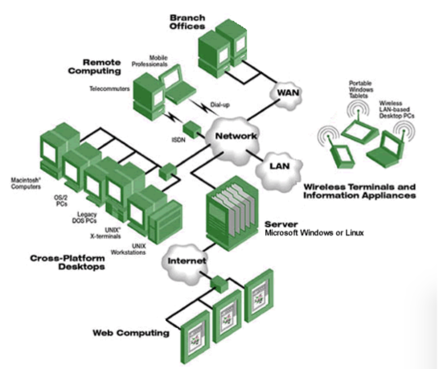
Types of Networks
LAN
WAN
VLAN
SAN
WLAN
Intranet
Extranet
VPN
PAN
P2P

Slide 18
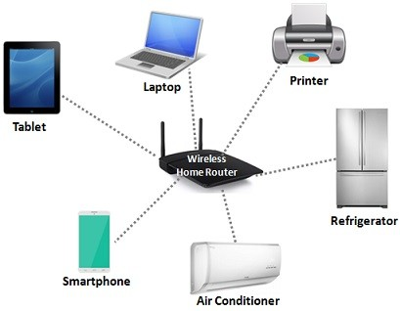
LAN (Local Area Network)
Covers a single building or collection of buildings
Less than 1KM radius

Slide 19
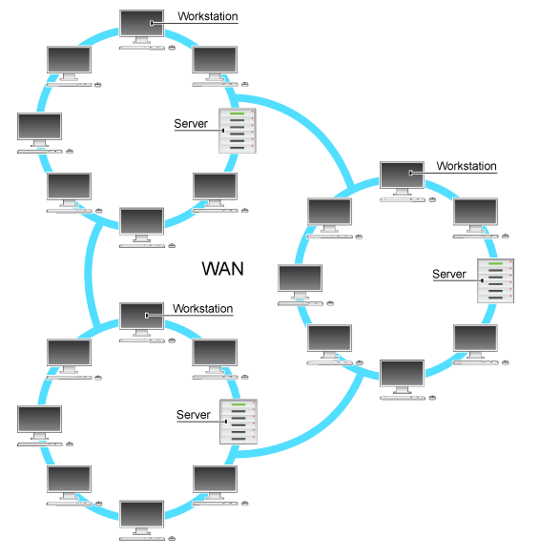
WAN (Wide Area Network)
Covers more distance than LAN
Greater than 1KM radius
Often uses multiple routers
May be several LANs connected together
May use leased lines
Examples: Internet, Cellular Network, ATM network

Slide 20
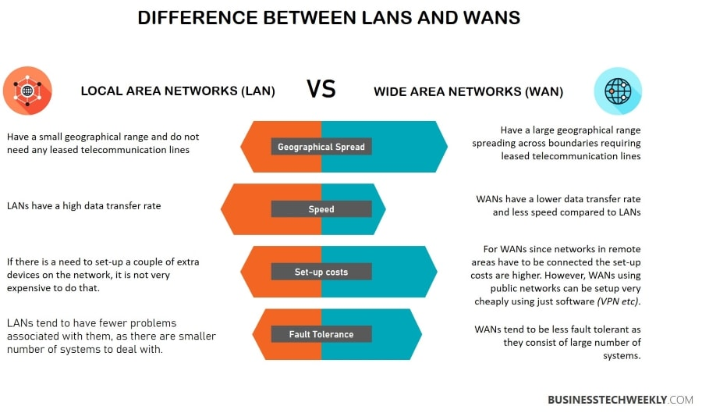

Slide 21
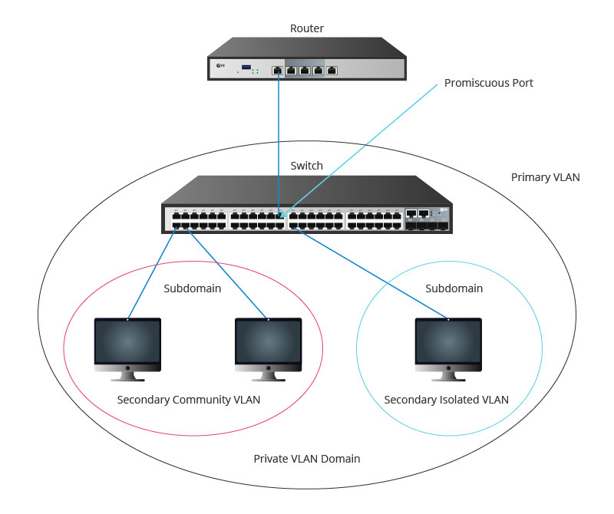
VLAN (Virtual Local Area Network)
1 or more physical LAN (local area network)
Network switch used to divide network
Works as multiple networks
More than the number of physical networks
Each VLAN may have different security requirements
Appears to an outsider as 1 LAN or WAN

Slide 22
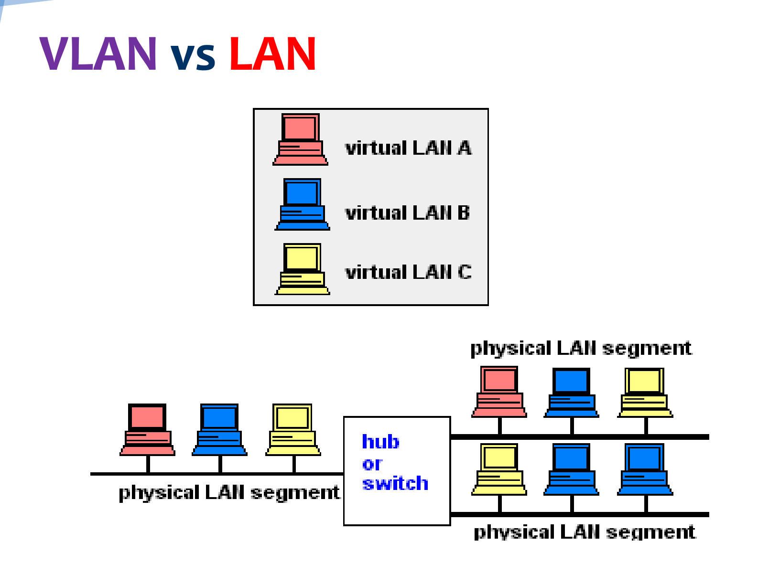

Slide 23
VLAN vs LAN - Similarities and Differences
Similarities | Differences
Used to connect devices | Better performance
Share resources | More flexible
 | Safer
 | More complex to set up and maintain
 | Better for larger organizations

Slide 24

SAN (Storage Area Network)
Network of storage devices
Often appear as attached drives
Purpose specific servers (email server, application server, database server, storage server, etc.)
Backup servers, battery backup in case of disasters
Not accessible through LAN
Better performance

Slide 25
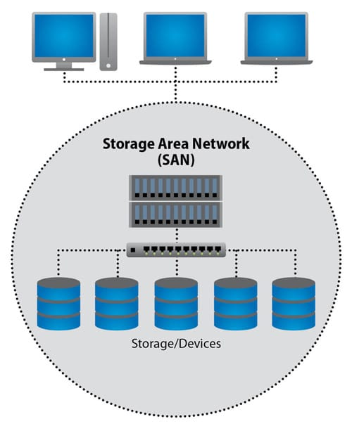

Slide 26
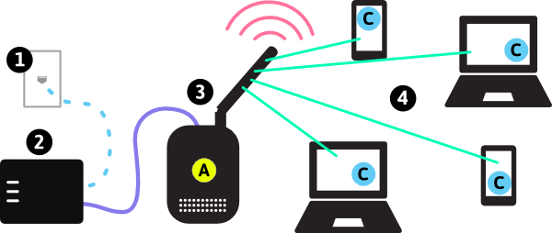
WLAN (Wireless Local Area Network)
LAN by which devices are connected by high-frequency data waves
Requests and responses from the internet (internet access
Uses can move around
“Wifi network”
Uses type of radio waves called Wifi (Wireless Fidelity)

Slide 27
Advantages and Disadvantages of WLAN
Advantages | Disadvantages
Can use unlicensed radio spectrum (reduces cost) | Interference
No cables (reduces cost) | Limited range
Can move around | Security
Global Standards (ex: 802.11n) | Health concerns?
Minimal setup costs

Slide 28
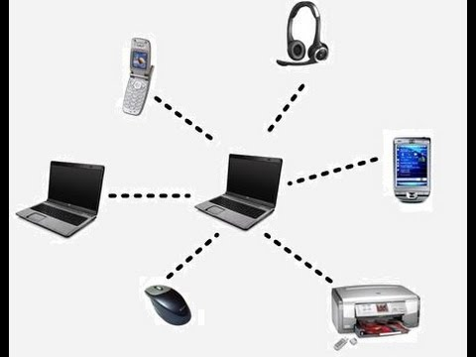
PAN (Personal Area Network)
Connects devices in a user’s immediate area
Radius of several meters
Examples include wifi hotspots, bluetooth devices

Slide 29
Intranet and Extranet
Private network
Sort of a “private internet”
Uses TCP/IP
Can view webpages similar to those on the internet
Intranet webpages only accessible from computers on network
If the intranet system is accessible through an online portal, it becomes an extranet.
North Korea - nationwide intranet

Slide 30
VPN (Virtual Private Network)
You use a VPN client, like NordVPN or something similar.
From your VPN client, you send all your requests, like www.google.com to a VPN server
The VPN server makes a request to that internet resource on your behalf and the VPN server returns the response to you via the VPN client
Connection with VPN server encrypted.
The process of creating and maintaining an encrypted connection between the server and client is called tunneling.
This encryption is done using an encryption technology like SSL, TLS, or IPSec.

Slide 31
VPN Advantages
Authentication
Encryption cannot be changed by outsider
Encryption
Data cannot be accessed or altered
Tunneling
Data can be be secured using proprietary protocols of company or external VPN provider
Multiple Exit Nodes
Origin of initial data packets unclear
Data can appear to originate from multiple IP Address

Slide 32
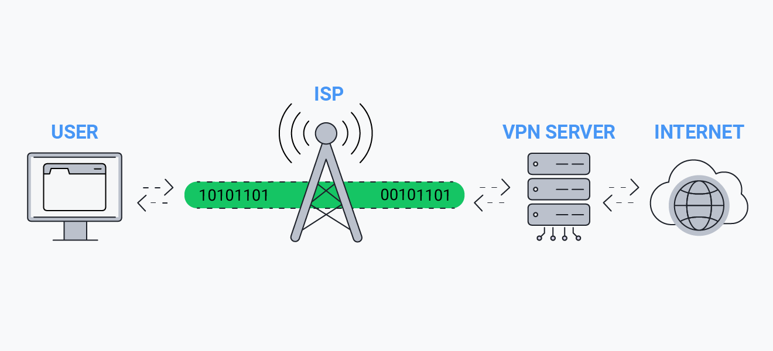

Slide 33
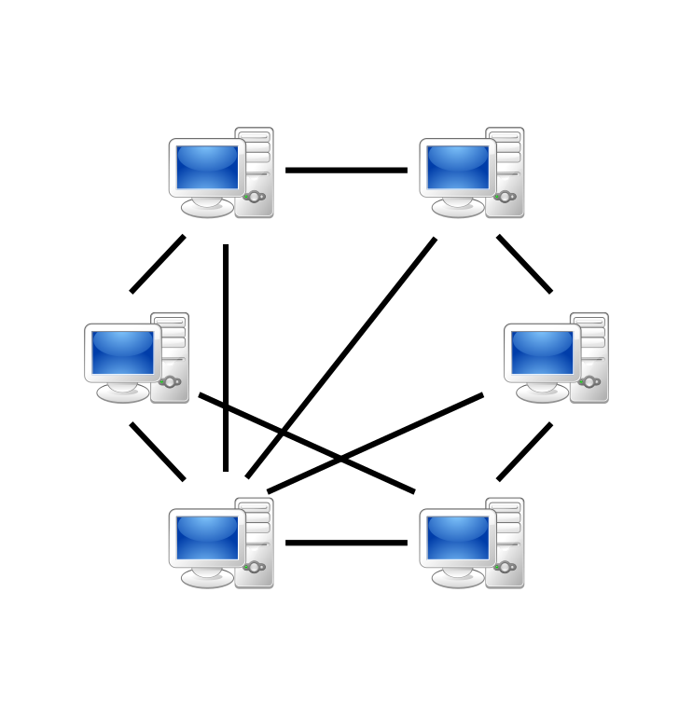
P2P (Peer to Peer Network)
Allows 2 or more computers to share resources with each other
Each computer acts as both a client and server
No central point

Slide 34
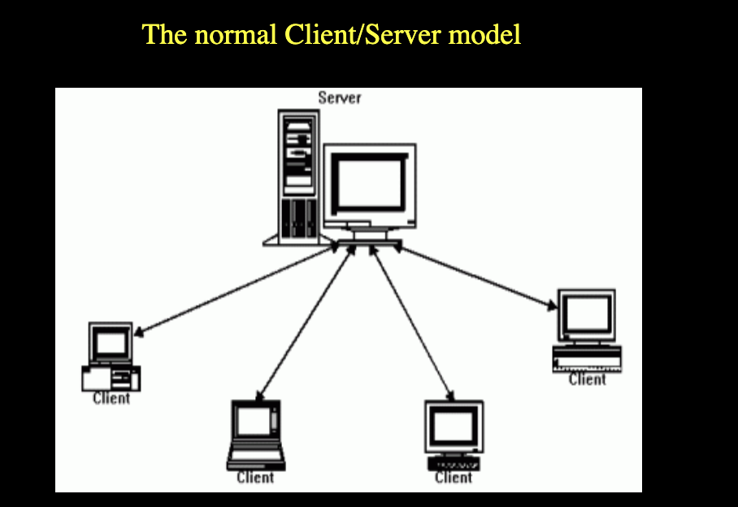
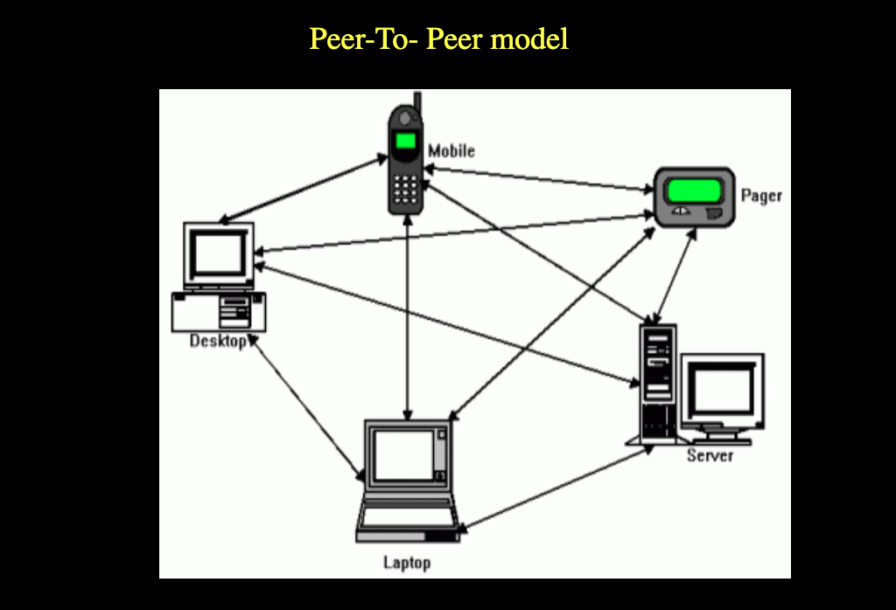

Slide 35
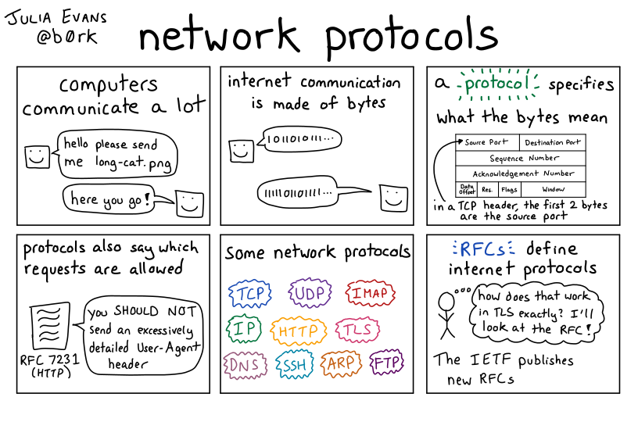
What is a protocol?
A protocol is a set of rules for data transmission (data packets)
TCP/IP - Rules for transmitting data on the internet
HTTPS - Rules for securely transmitting data between a web browser and a server
SFTP - Rules for securely transferring files from client to server

Slide 36
Role of Protocols
Maintain Data Integrity - same data that is sent is received
Flow Control - data is sent and received at the same rate
Prevent Deadlock - two packets don’t “block each other”
Prevent Errors - Make sure no errors introduced in transit

Slide 37
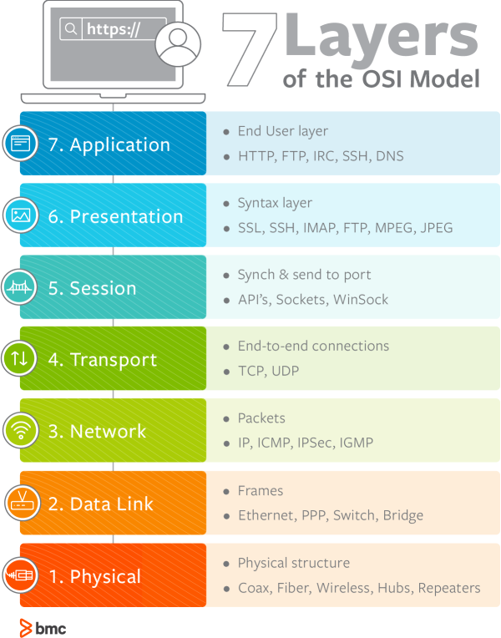
OSI Model (Open Systems Interconnection) Model
For IB Exam, know at least 3 layers

Slide 38
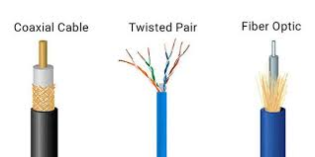
Transmission Media
Physical media by which data packets are transmitted
Two types - wired and wireless
Wired - Ethernet, Fiber Optic, Copper
Wireless - Radio Waves (WLAN), Microwave, Wireless
4 Factors to Consider
Security
Reliability
Cost
Speed

Slide 39
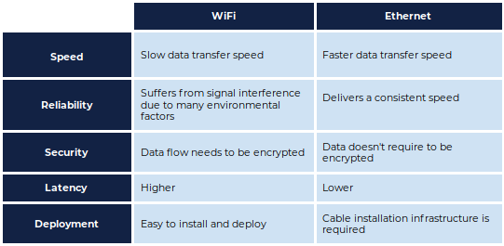

Slide 40
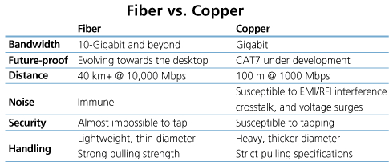

Slide 41
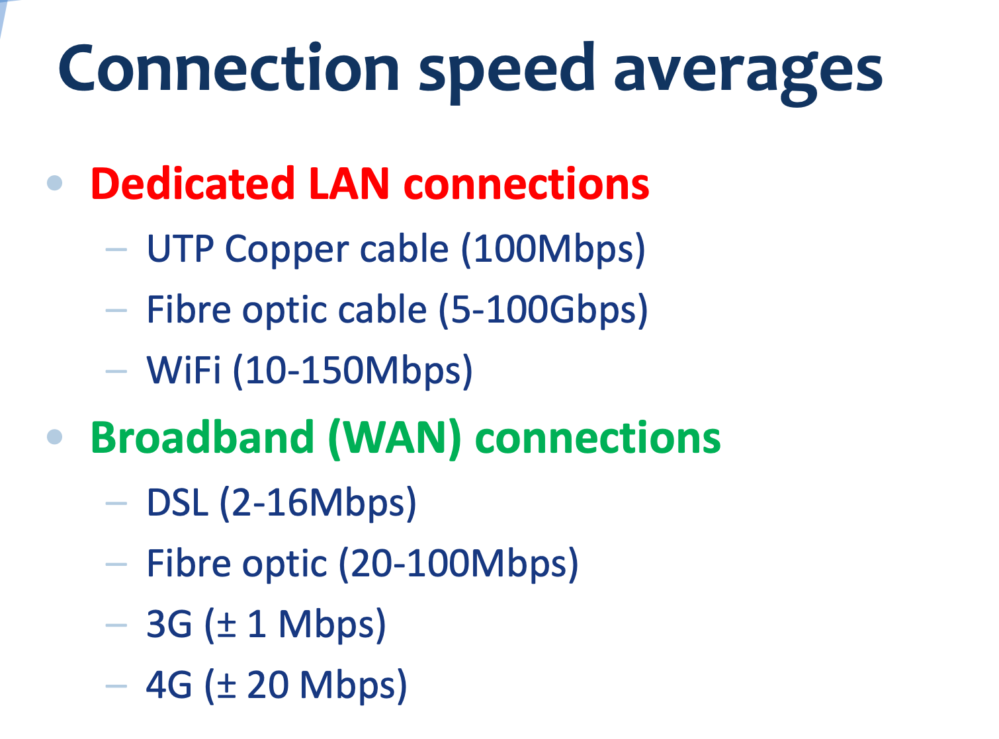

Slide 42
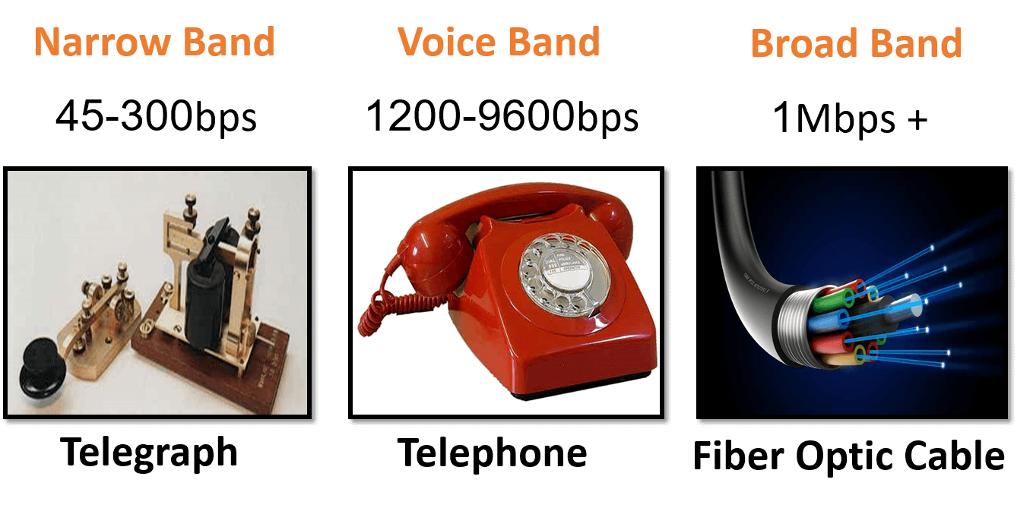
Transmission Speed
Primary Factors
Traffic
Secondary Factors
Time of Day
Distance
Infrastructure
Tertiary Factory
Environmental Issues (Temperature, Interference)
Financial Factors (Cheaper equipment, etc.)
Type of Data (Size, streaming, etc.)

Slide 43
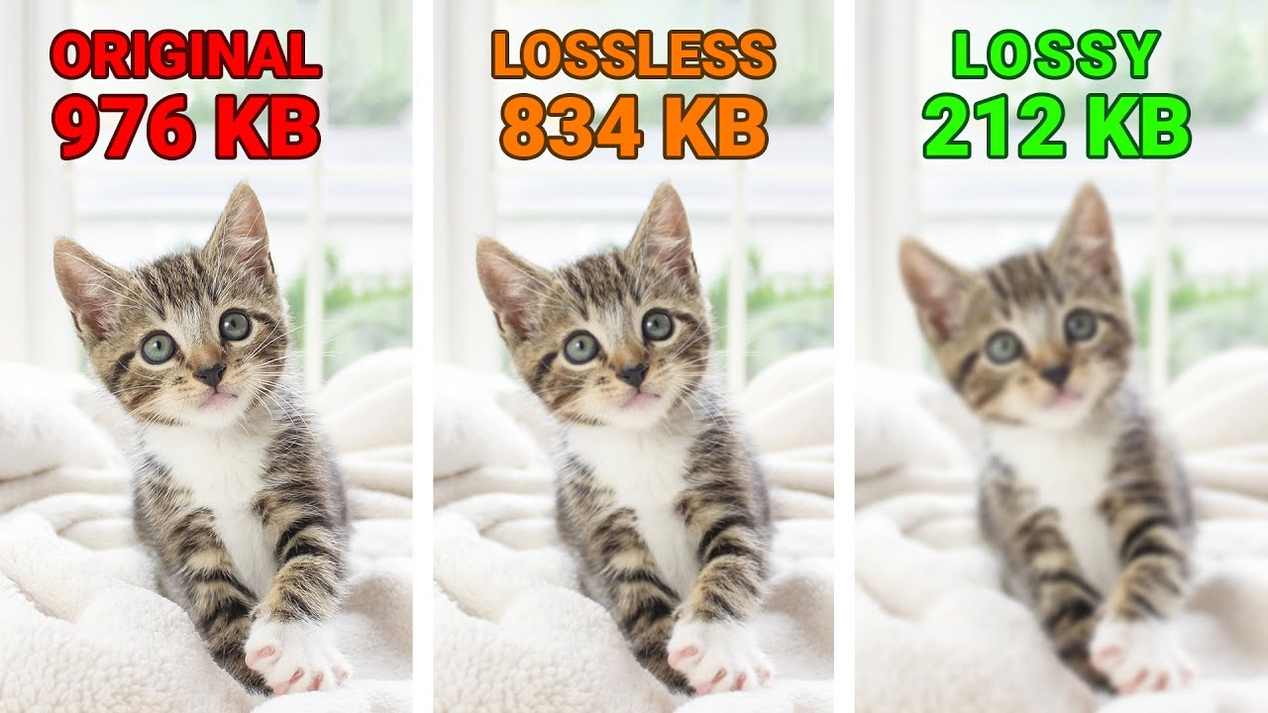
Compression
Lossy Compression
Removes data
Smaller file size
Irreversible
Used when some data can be lost (videos, images, etc.)
Lossless
Uses algorithm to reduce file size
Larger than lossy, but smaller than normal
Reversible
Used when no data can be lost (text, software, etc.)

Slide 44
Network Security

Slide 45
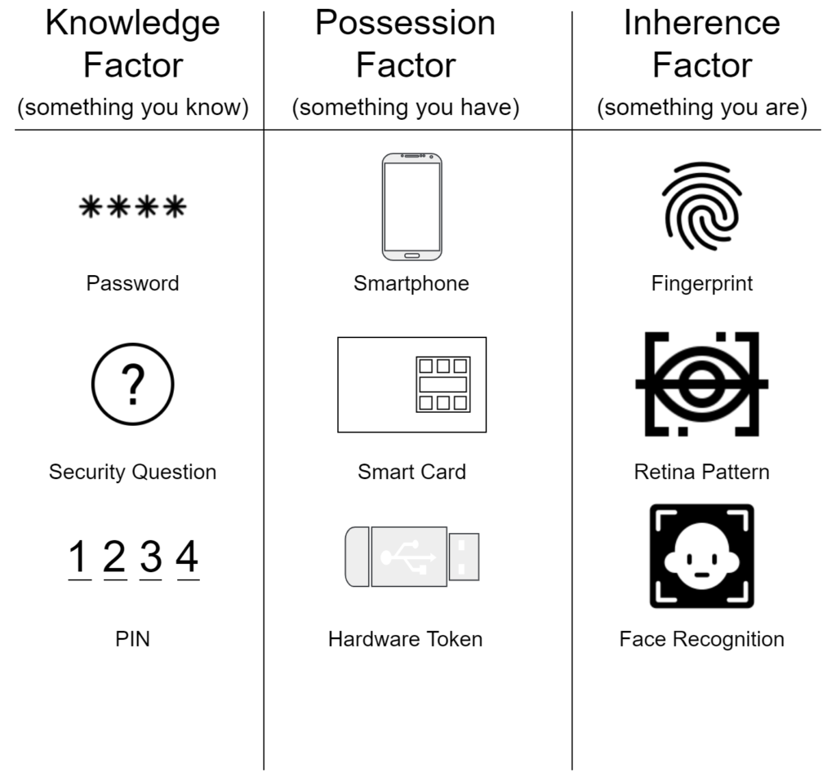
Authentication
One factor - use one way
Ex: Password
Two factor - use two ways
Ex: Password, Text Message
Three factor - use three ways
Ex: Password, Text Message, Thumbprint

Slide 46
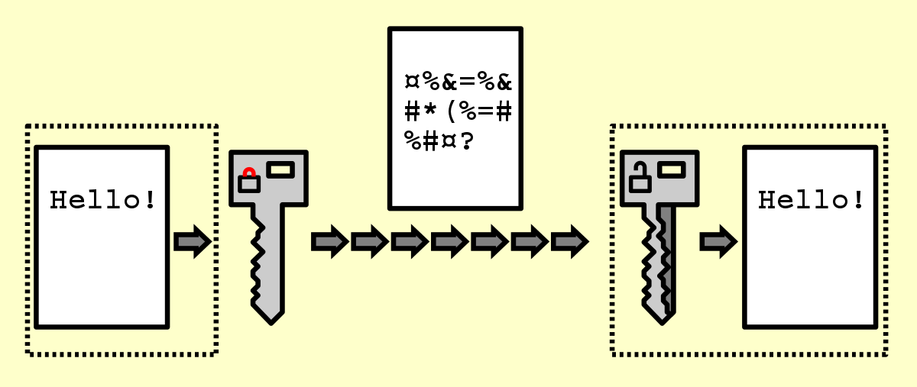
Encryption
Encodes data
Data can only be read by sender and receiver
Involves a “key”

Slide 47
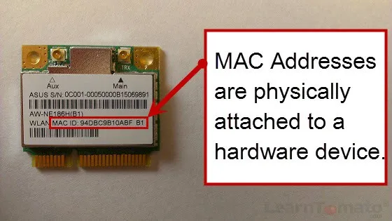
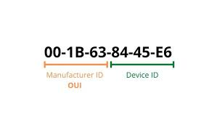
MAC (Media Access Control) Address
Used to identify network-enabled devices in networks
“Hard-coded” by manufacturer
Network interface controller
Unique, 6 pairs of 2 hexadecimal digits
Check against white list

Slide 48
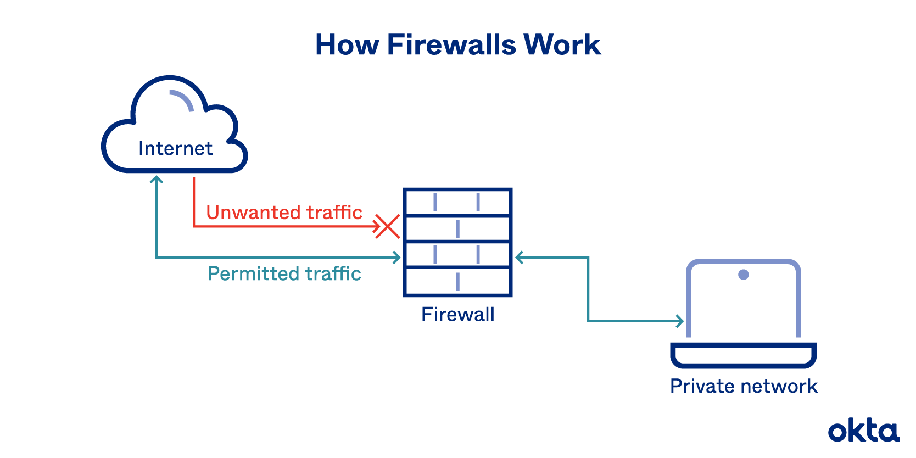
Firewalls
Can be hardware- or software-based
Analyzes data packets
Controls incoming and outgoing traffic according to predetermined rules
Filter based on MAC addresses

Slide 49
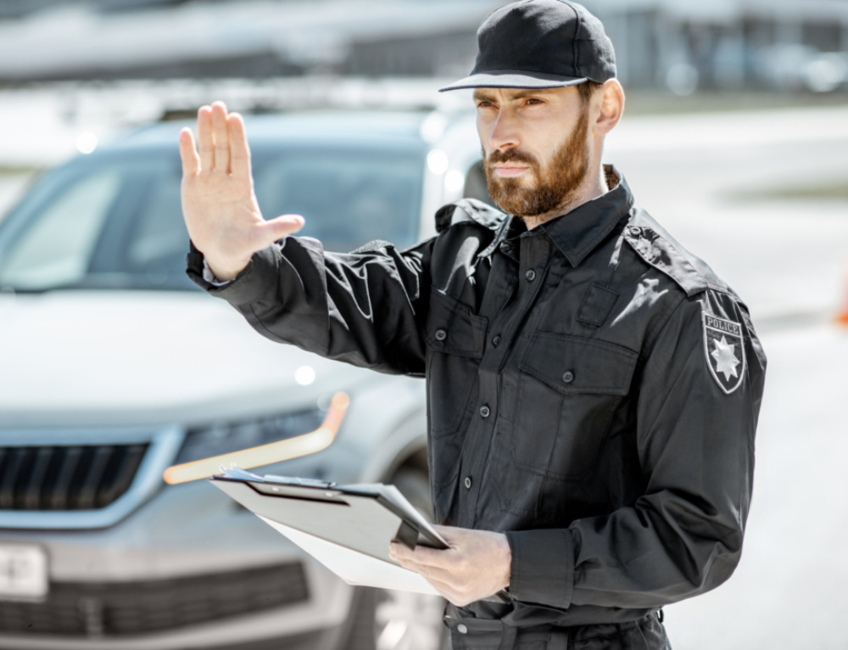
Physical Security
Locked doors
Cages
Security Guards
Secure Rooms
Hurricane/Earthquake Proof
EMP-Insulated

Slide 50
IB Questions

Slide 51
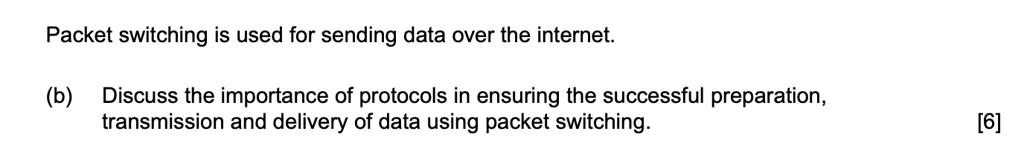

Slide 52
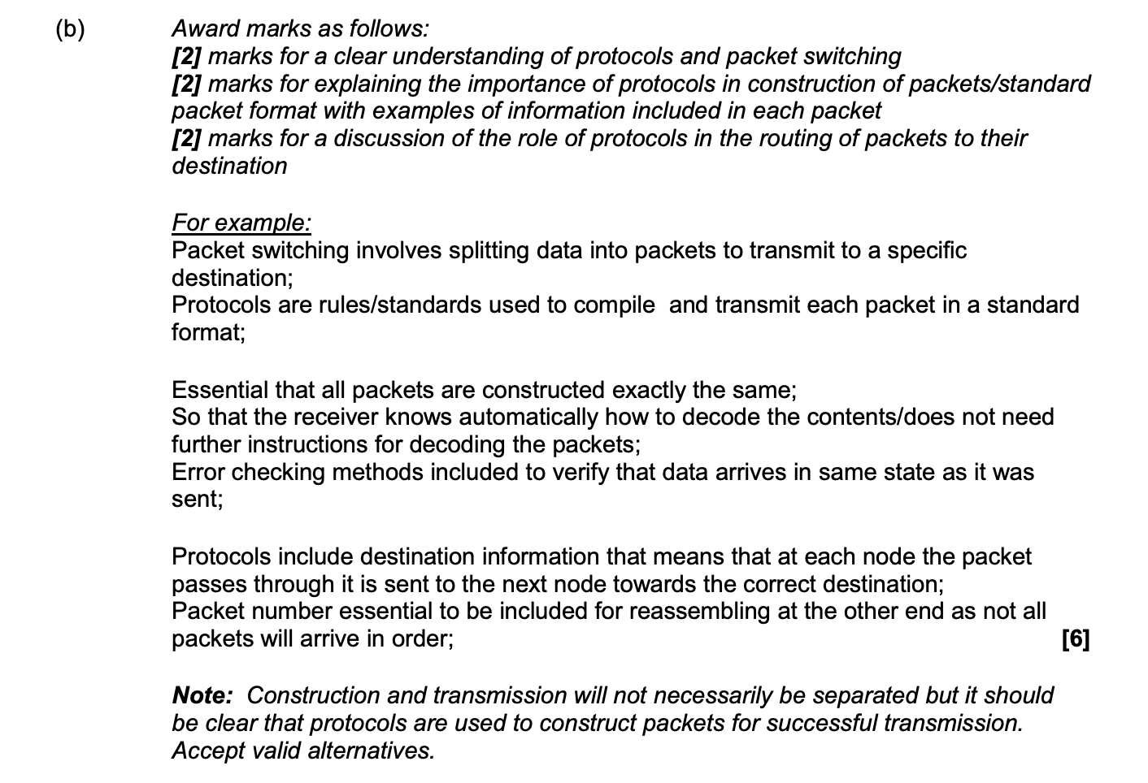

Slide 56
IB Question

Slide 57
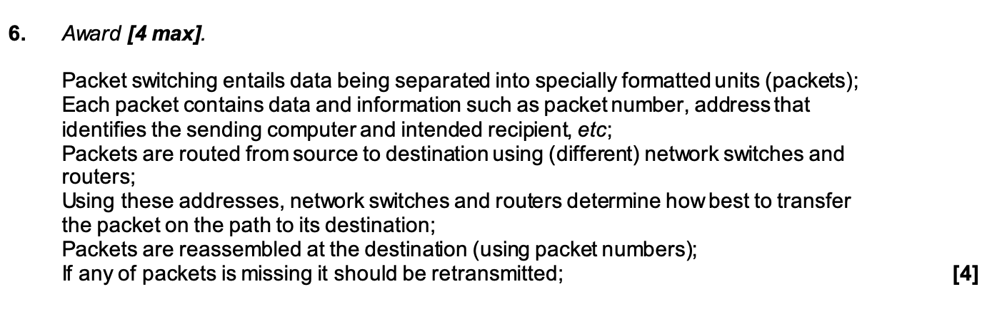

Slide 58
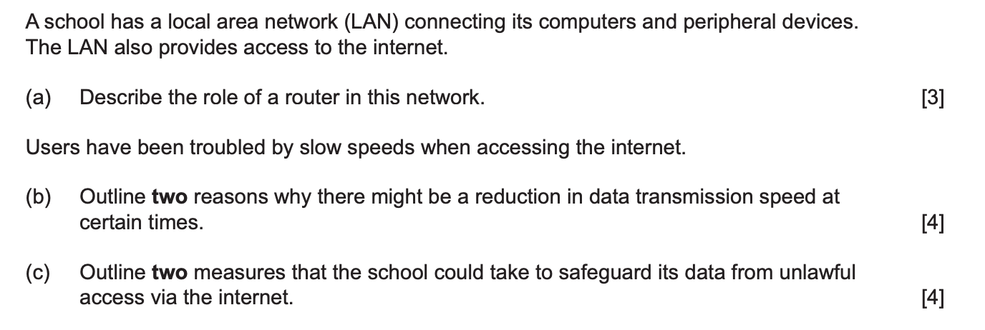

Slide 59
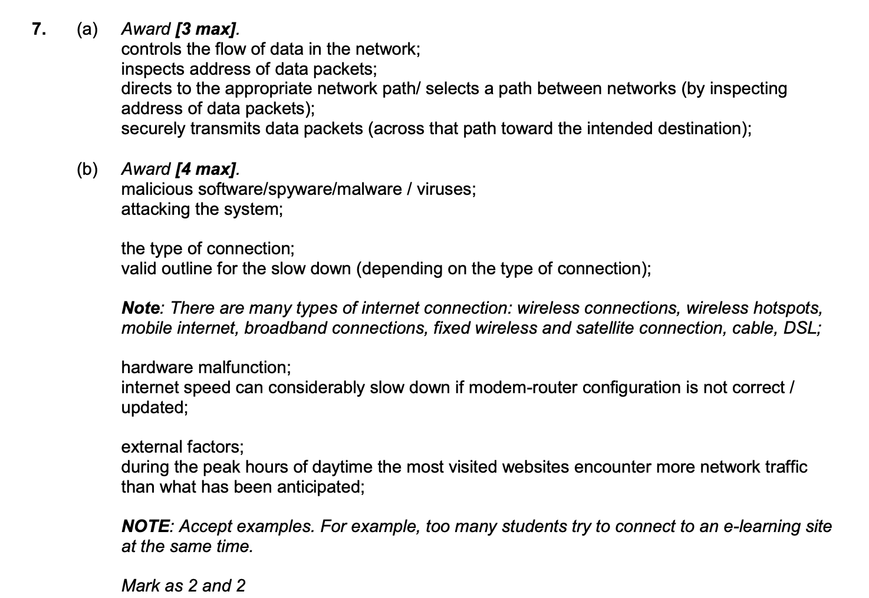

Slide 60
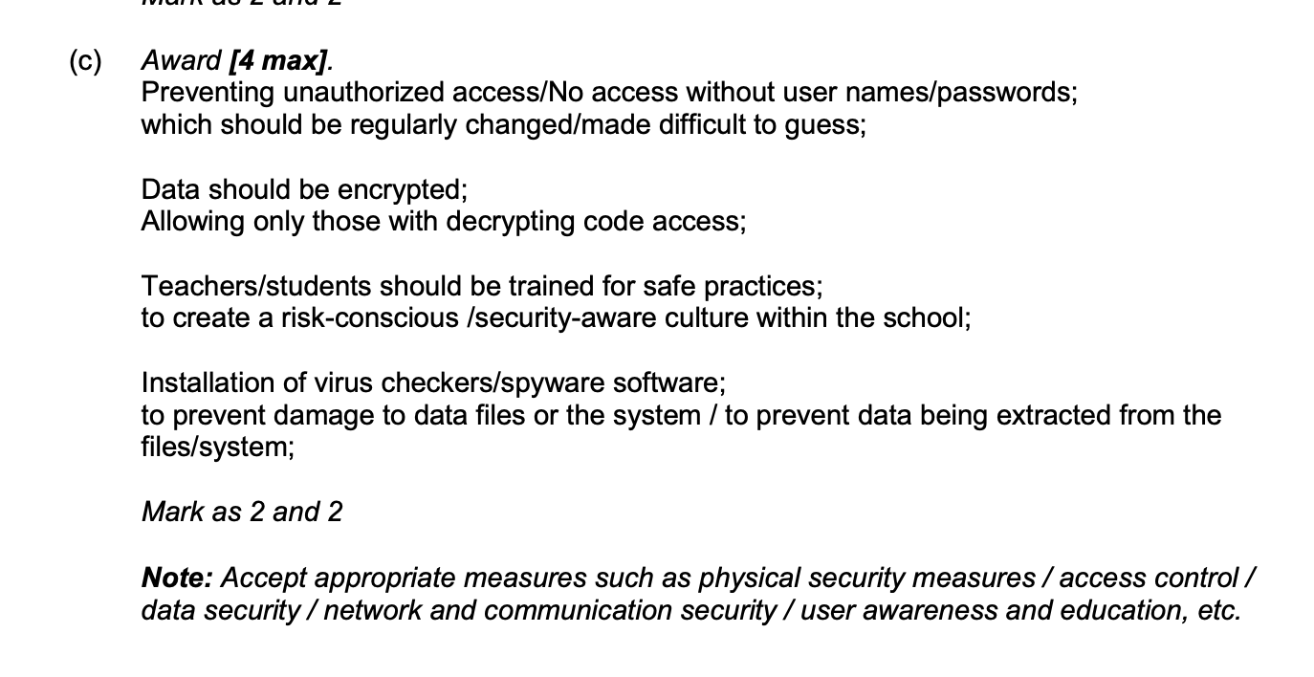

Slide 61
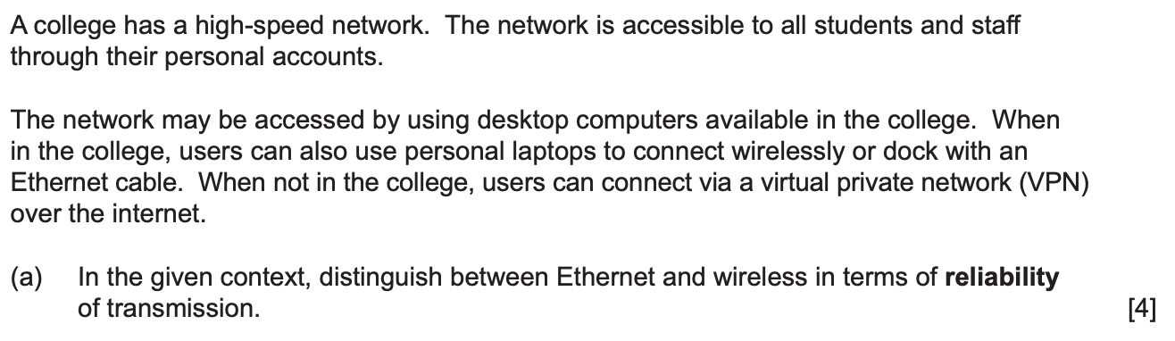

Slide 62
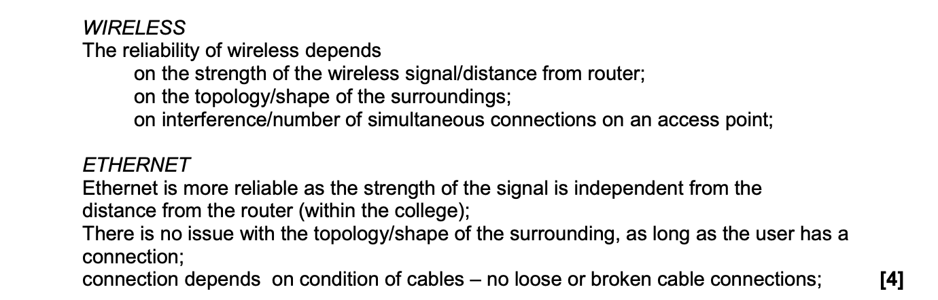

Slide 63
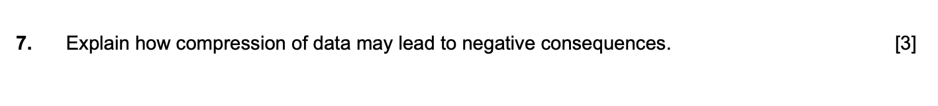

Slide 64
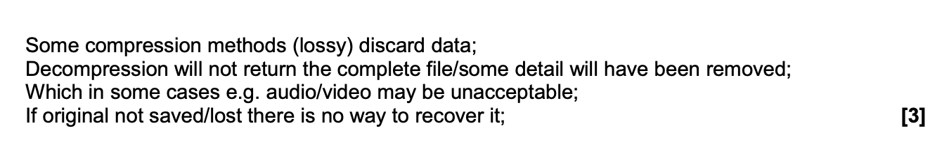

Slide 66
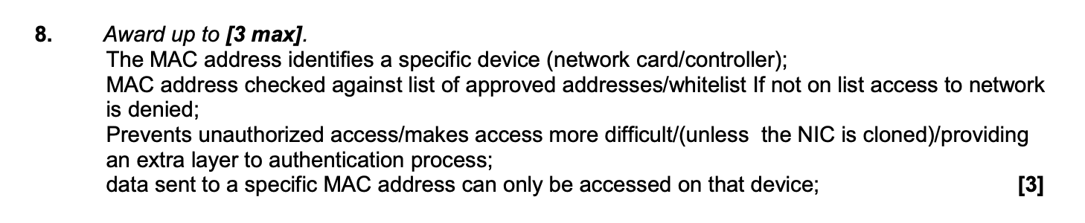

Slide 67
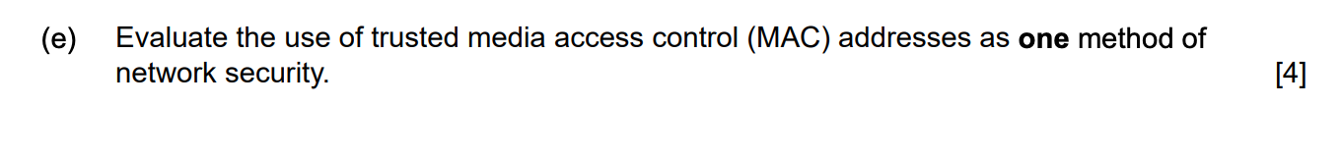

Slide 68
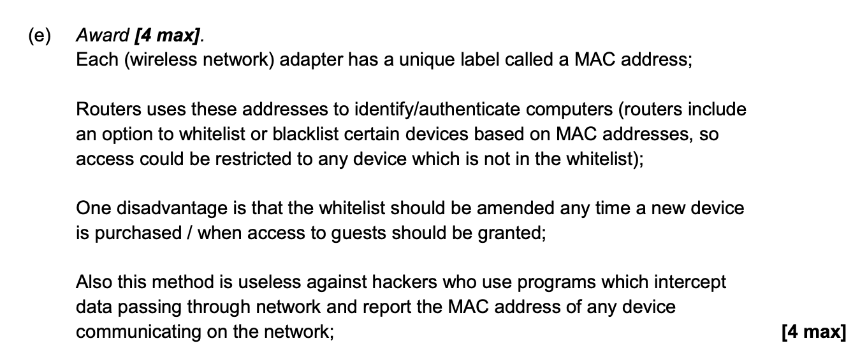

Slide 69
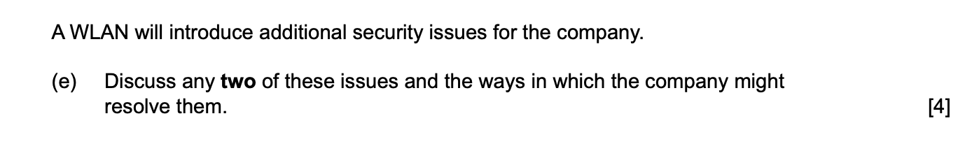

Slide 70
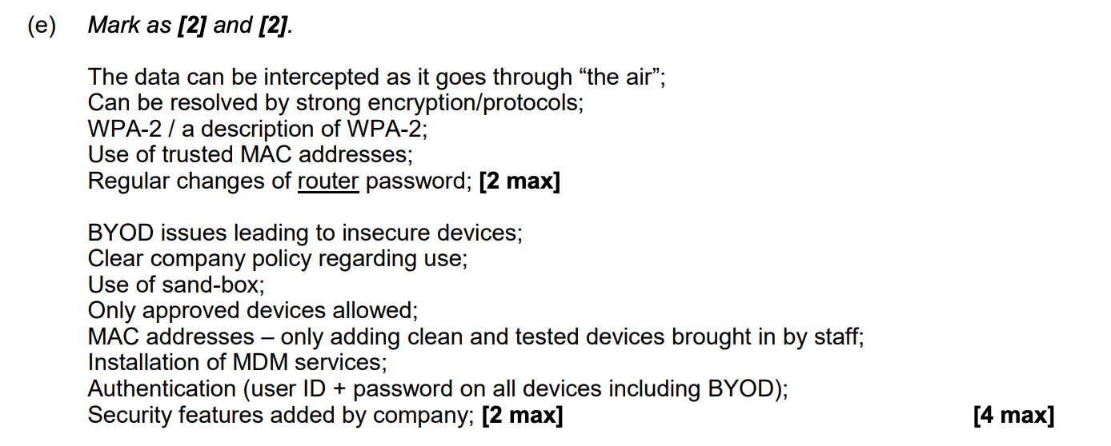

Slide 71


Slide 72


Slide 73


Slide 74


Slide 75


Slide 76


